Slide 1
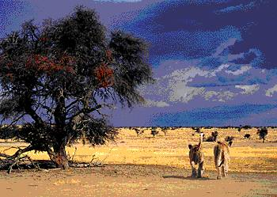
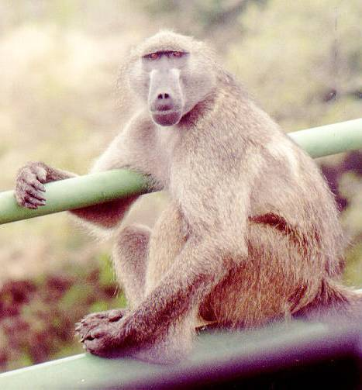
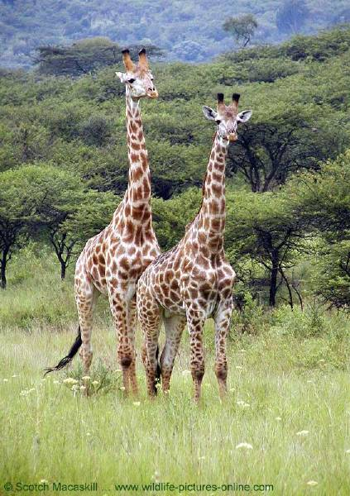
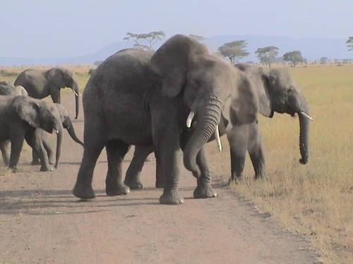
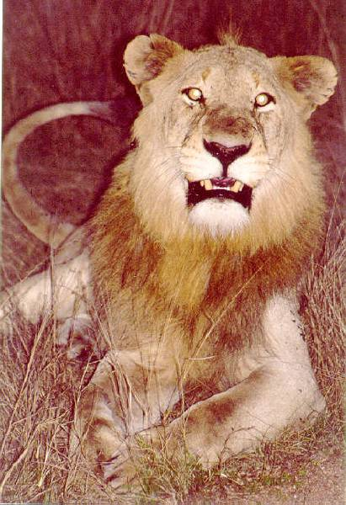
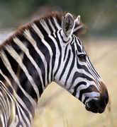
The
Geography
of
Africa
Mr. Clutter
VMS Library

Slide 2
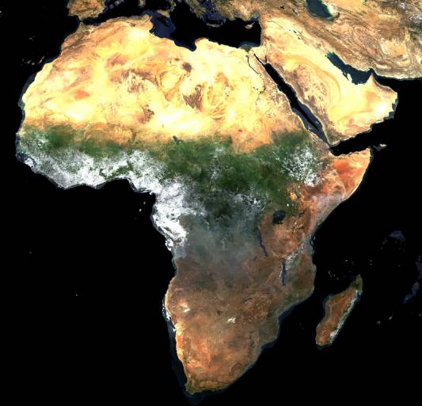
A Satellite View

Slide 3
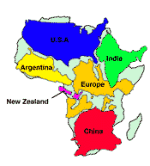
Africa’s Size
4 6 0 0 M I L E S
5 0 0 0
M I L E S
Second largest continent → 11,700,000 sq. mi.
10% of the world’s population.
2 ½ times the size of the U. S.

Slide 4
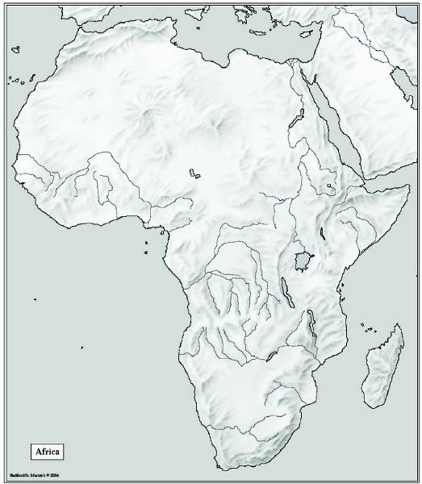
Mediterranean Sea
Bodies
Of
Water
Red Sea
Nile River
Niger River
L. Chad-->
<--Gulf of Aden
L. Albert-->
Congo River
L. Victoria
L. Tanganyika->
Indian Ocean
Atlantic Ocean
Zambezi River
Limpopo River
Orange River
Pacific Ocean

Slide 5
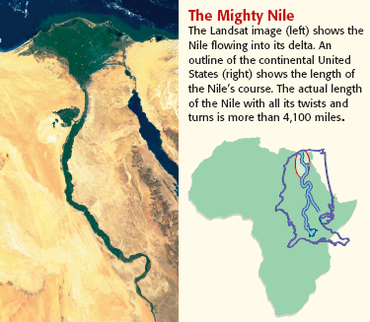
The Mighty Nile River: “Longest River in the World”

Slide 6
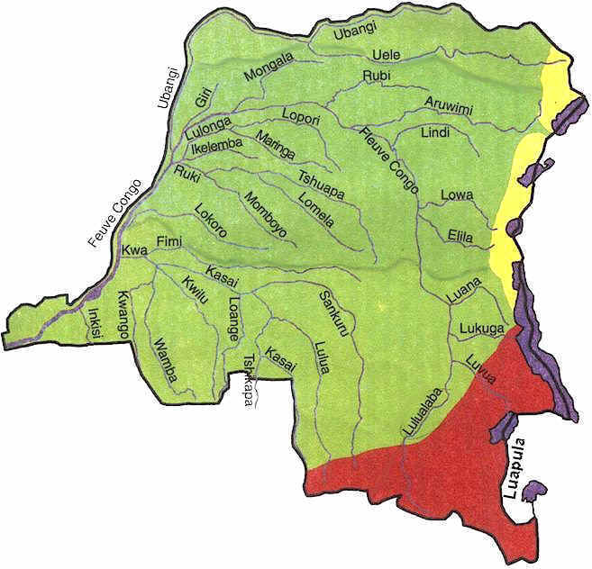
The Congo River Basin
Covers 12% of the continent.
Extends over 9 countries.
2,720 miles long.
99% of the country of Zaire is in the Congo River basin.

Slide 7
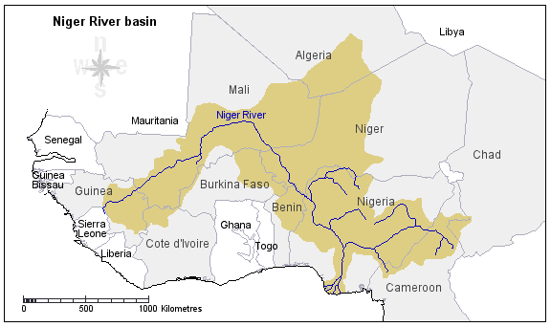
The Niger River Basin
Covers 7.5% of the continent.
Extends over 10 countries.
2,600 miles long.

Slide 8
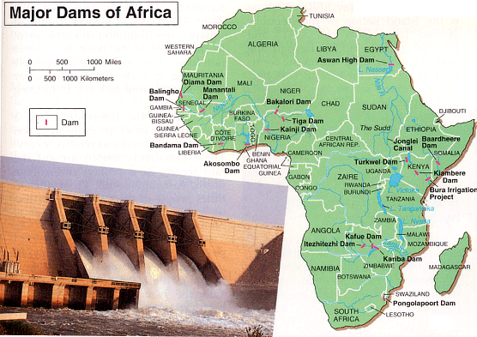
Hydroelectric Power

Slide 9
Atlas Mts.
Mountains
&
Peaks
Δ Mt. Kenya
Δ Mt. Kilimanjaro
Ruwenzori Mts.
Drajensburg Mts.

Slide 10
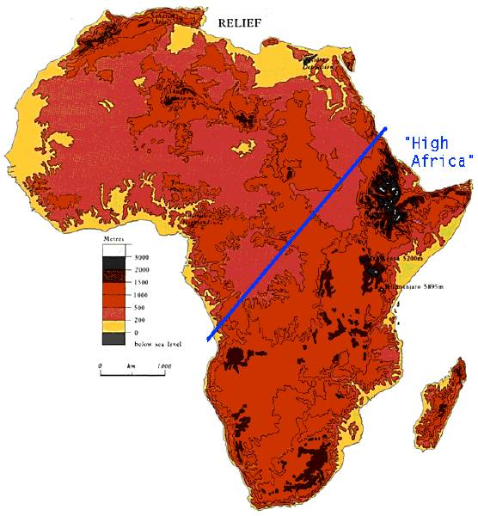
The African Plateau

Slide 11
Libyan Desert
Deserts
Sahara Desert
Sahel
Namib Desert
Kalahari Desert

Slide 12
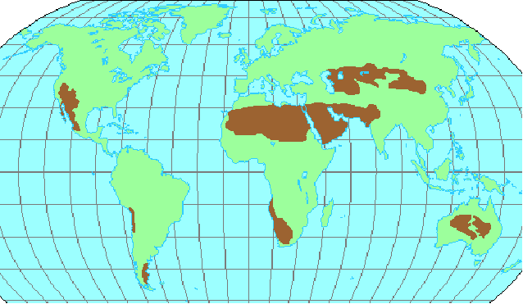
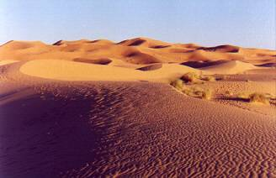
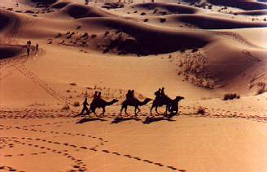
The Sahara Desert

Slide 13
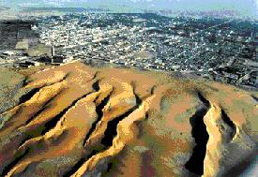
Desertification

Slide 14
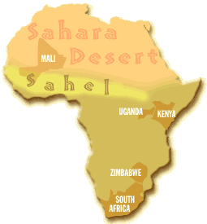
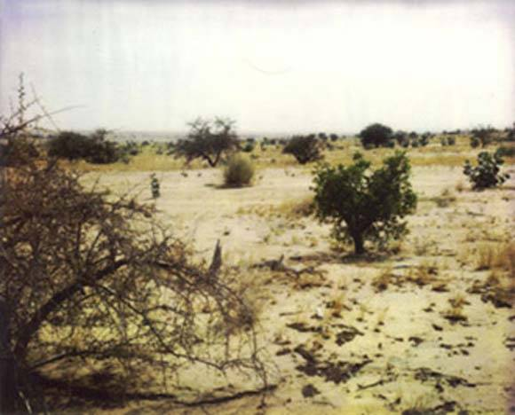
The Sahel

Slide 15
Valleys
&
Plains
Great Rift Valley

Slide 16
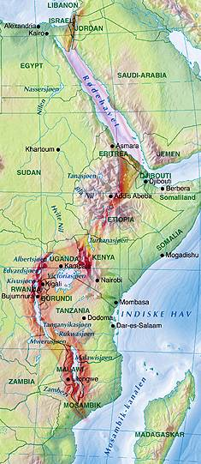
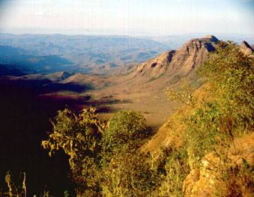
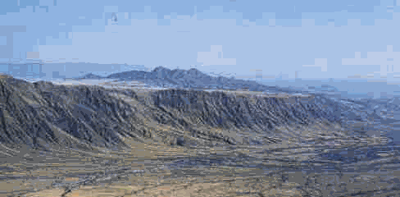
Great Rift Valley
3,000 miles long

Slide 17
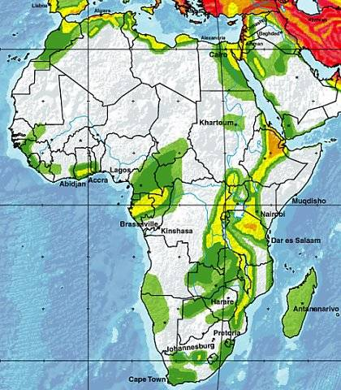
Seismic Activity in Africa

Slide 18
Africa: The “Tropical” Continent
Tropic of Cancer 20° N
Equator 0°
Tropic of Capricorn 20° S

Slide 19
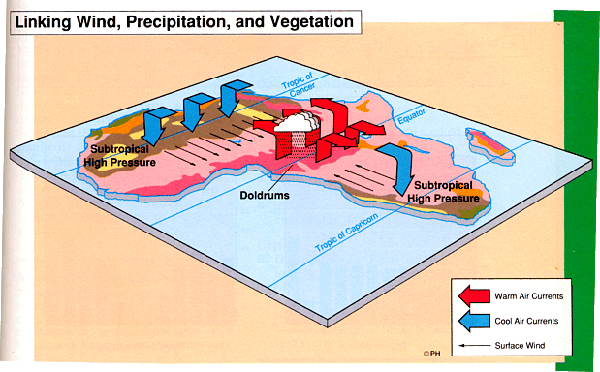
African Trade Winds

Slide 20
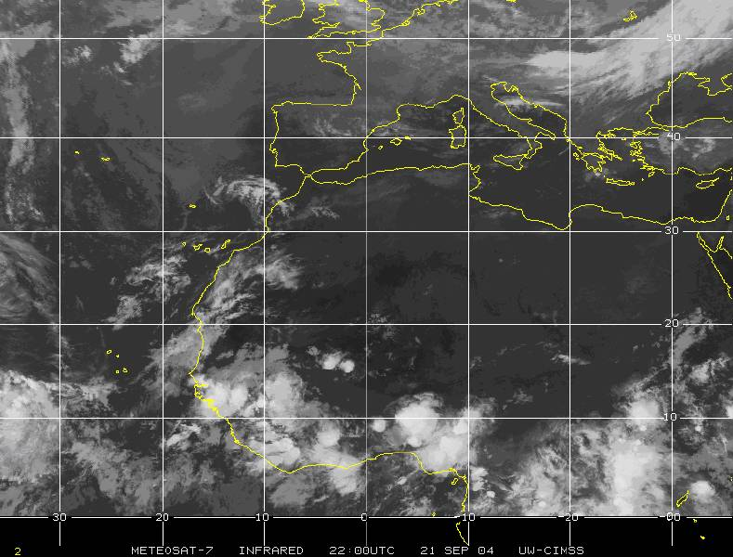
West Africa: Home of our Hurricanes

Slide 21
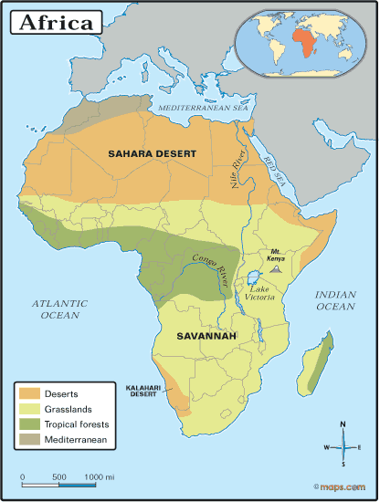
Vegetation Zones

Slide 22
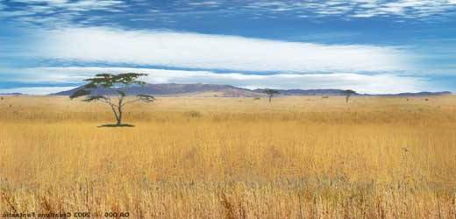
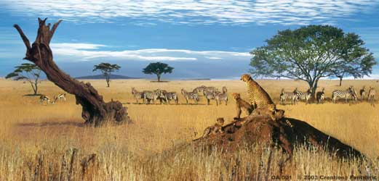
The African Savannah: 13 million sq. mi.

Slide 23
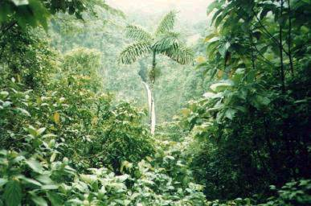
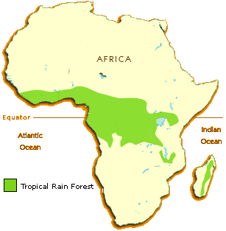
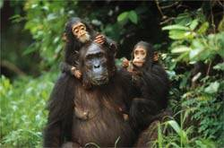
African Rain Forest
Annual rainfall of up to 17 ft.
Rapid decomposition (very humid).
Covers 37 countries.
15% of the land surface of Africa.

Slide 24
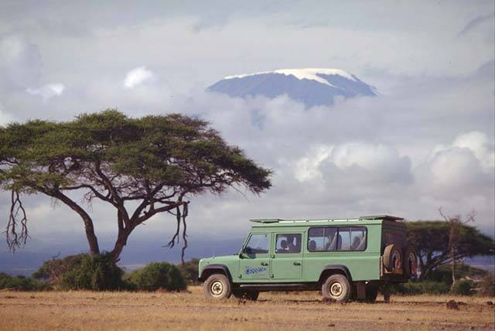
Mt. Kilimanjaro: Snow on the Equator?

Slide 25
Atlas Mts.
Mediterranean Sea
Libyan Desert
The
Complete
Topography
Of
AFRICA
Tropic of Cancer 20° N
Sahara Desert
Red Sea
Sahel
Nile River
Niger River
L. Chad-->
Great Rift Valley
<--Gulf of Aden
L. Albert-->
Equator 0°
Congo River
Δ Mt. Kenya
L. Victoria
Δ Mt. Kilimanjaro
L. Tanganyika->
Indian Ocean
Ruwenzori Mts.
Atlantic Ocean
Zambezi River
Namib Desert
Kalahari Desert
Tropic of Capricorn 20° S
Limpopo River
Orange River
Drajensburg Mts.
Pacific Ocean

Slide 26
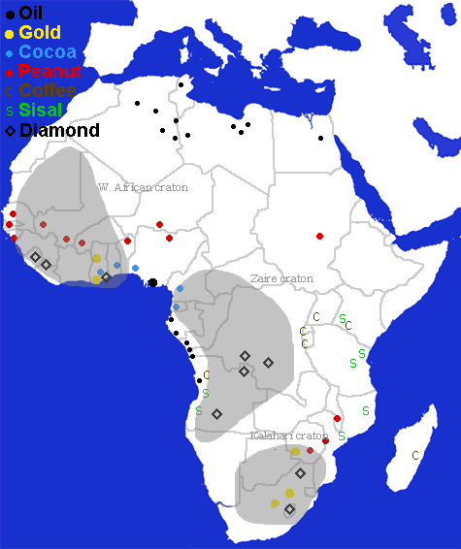
Natural Resources

Slide 27
This powerpoint was kindly donated to www.worldofteaching.com
http://www.worldofteaching.com is home to over a thousand powerpoints submitted by teachers. This is a completely free site and requires no registration. Please visit and I hope it will help in your teaching.

